Slide 1
SPC – Statistical Process Control
U7 – Control
E1 – Statistical Process Control (SPC)
The element ‘Statistical Process Control’ explains the controls methods used to identify out-of-control situations and deviations over time. Different types of SPC charts are reviewed.
Yellow Belt
Notes:
Welcome to this Lean Six Sigma Academy Yellow Belt in Healthcare training module.

Slide 2
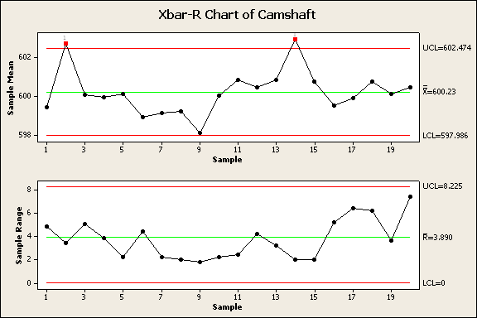
Statistical Process Control
Objectives and benefits
  Tells you if the process is stable or unstable
  Does NOT tell you if you’re process is producing products or services within customer specifications
Notes:
As we explained in a previous module, customers today are demanding more and more that products are centered on “target”; it is not sufficient anymore to produce only between the upper and lower specification limits. In addition, the spread of the process must be clearly less than the range of the specification limits. In this way, the customer receives an optimal product with acceptable production costs. By using statistical process control or SPC, we can see if a process is stable or not, however SPC will not show us whether or not we are producing within customer specifications. The control limits in the graph are the three sigma borders of the process and will tell us if we have points with an improbable spread. In the X-bar R control chart shown, we can see two red points that fall outside the three sigma borders of this control chart, this indicates that this process is not stable.

Slide 3
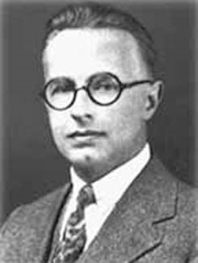
Statistical Process Control
Variation
  ‘Common cause’ variation: Inherent to the process itself (noise)
  Can only be reduced by changing or improving the process itself
  ‘Special cause’ variation: caused by special causes and situations (signal)
‘Data contain both signal and noise. To be able to extract information, one must separate the signal from the noise within the data.’
- Walter E. Shewhart -
Notes:
To be able to draw accurate conclusions from the graphs, we must understand that variations in a process can be caused by two different components. The ‘noise’ or ‘common cause variation’ is a part of the process so improvement can only be reached if the process itself is changed. The ‘special cause variation’ is cause by influences or situations outside the process. We must separate the noise from the signal to draw a correct conclusion.

Slide 4
Statistical Process Control
Common cause variation (noise):
  Is inherent to the process
  Every process shows common cause variation
  It is produced by the process itself (the way we do business)
  It can be reduced or eliminated, but only by a fundamental change in the process
  A process showing only common cause variation is ‘stable’, ‘predictable’ and ‘in-control’
Notes:
When we talk about ‘noise’ or ‘common cause variation’ as a part of the process, it is dependent on how we have arranged the work process and the environment in which the process takes place. Only a fundamental change in the process can reduce the noise. We call a process stable, predictable and in-control if the process shows only common cause variation.

Slide 5


Statistical Process Control
Common cause variation
In the example of hot meals in Elderly home centre:
  There is a difference in walking distance to every customer
  Not every plate leaves the kitchen at the same time (some plates wait longer to be taken to the customers)
  Different cooks prepare at different temperatures
  The cover of the plate was not closed properly
Notes:
When we talk about ‘noise’ or ‘common cause variation’ as a part of the process, it is dependent on how we have arranged the work process and the environment in which the process takes place. Only a fundamental change in the process can reduce the noise. We call a process stable, predictable and in-control if the process shows only common cause variation.

Slide 6
Statistical Process Control
Special cause variation
  This is variation that cannot be explained by common causes alone
  It is often very large as compared to common cause variation
  It is caused by problems that can be identified and often eliminated
  SPC helps to detect special cause variation
  A process showing special cause variation
  is called ‘out-of-control’ and ‘instable’
Notes:
Special cause variation is often large as compared to common cause variation. SPC is the tool to use to make the distinction between common and special cause variation. If we detect special cause variation in our process, we can try to find the root cause of the variation and remove it. If special causes occur in practice, we call the process instable or ‘out-of-control’.

Slide 7
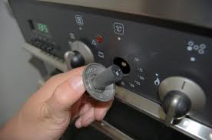
Statistical Process Control
Special cause variation
In the example of hot meals in Elderly home centre:
  The stove is not working properly any more
  The Elderly home centre has opened a new department which is closer to the kitchen
Notes:
An example of special cause variation in the hot meals example is that the stove is not working or some of the rooms are closer to the kitchen.

Slide 8
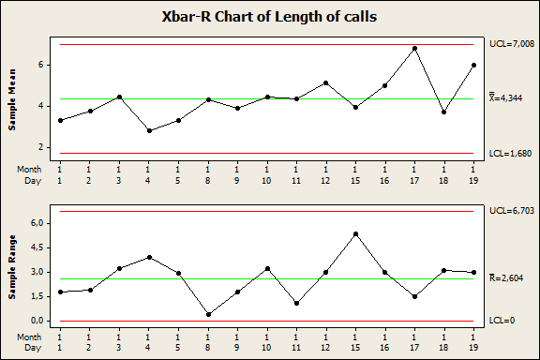
Statistical Process Control
Charts
  Example Xbar-R chart:
Notes:
Here we will discuss the control chart used for continuous data which is called X-bar R chart. X-bar stands for the averages or ‘means’ of the samples which are collected over time. In this way, we can see if ‘special cause’ arises outside the process control limits in the chart. Also, we are able to detect trends in time. Depending on the sample size within each X-bar chart, either a range or ‘R chart’ or a standard deviation or ‘S chart’ is chosen. Both the X-bar and the R chart must be in control.

